Slide 1
Acoustics at NHM
Ed Baker
Acoustic Biology Researcher Natural History Museum, London

Slide 2
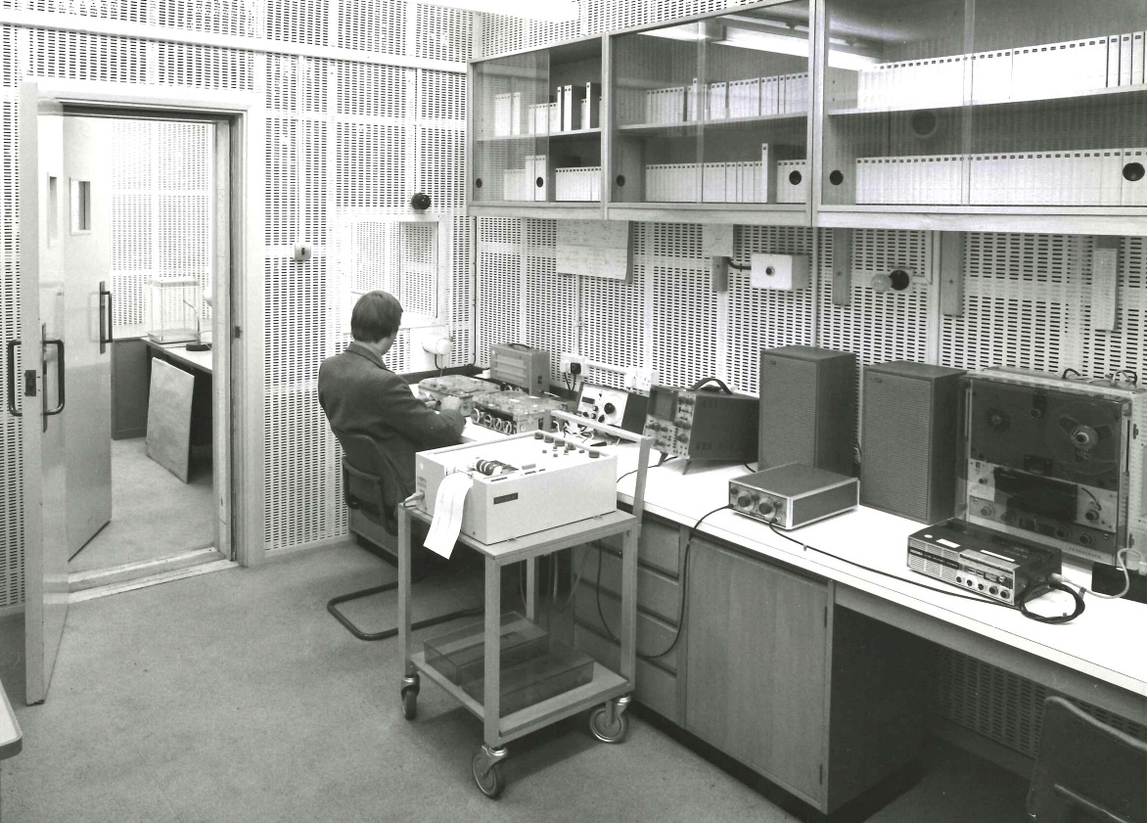
British Museum (Natural History) recording studio
1973-1998
bio.acousti.ca

Slide 3
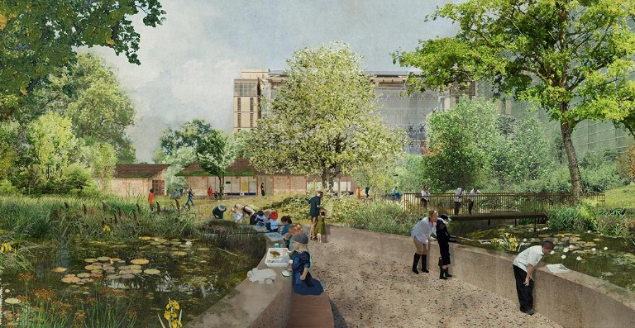
A Living Laboratory
Our gardens are a hub for urban nature identification and field survey skills

Slide 4
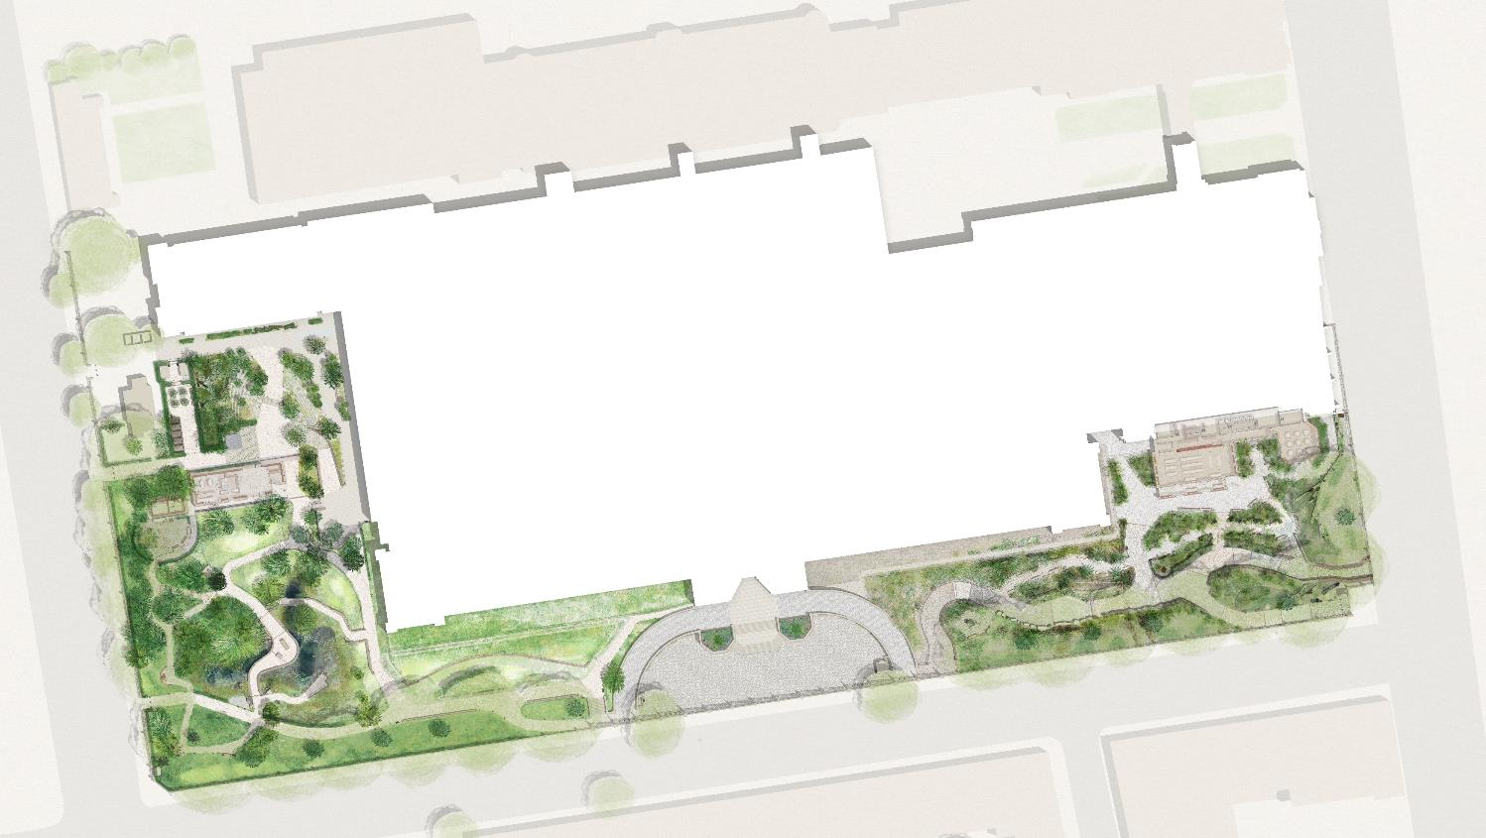
A Living Laboratory
Power-over-Ethernet locations
Long-term (intense, untargeted) monitoring plus detailed case studies of how habitat translocation, creation and restoration actions impact biodiversity
Over-specified (plenty of excess compute, transfer) – capacity to double number of devices. Testing arena for more targeted, less power hungry devices.
Background data:
One of the most intensively studied urban sites for 25 years

Slide 5
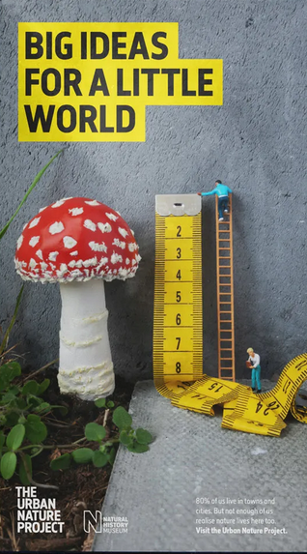
Acoustics in Urban Nature Project
Comprehensive survey of acoustic environments of the site
Airborne; freshwater; soil; timber
First year: complete dataset
Look at sampling in some subsequent years (museums like to keep stuff)
Some ultrasound, some arrays
Raspberry Pi devices
Familiar environment for researchers
Generic Linux fits with IT maintenance and security practices
Extensible with new sensors/capabilities
Cheap to replace

Slide 6
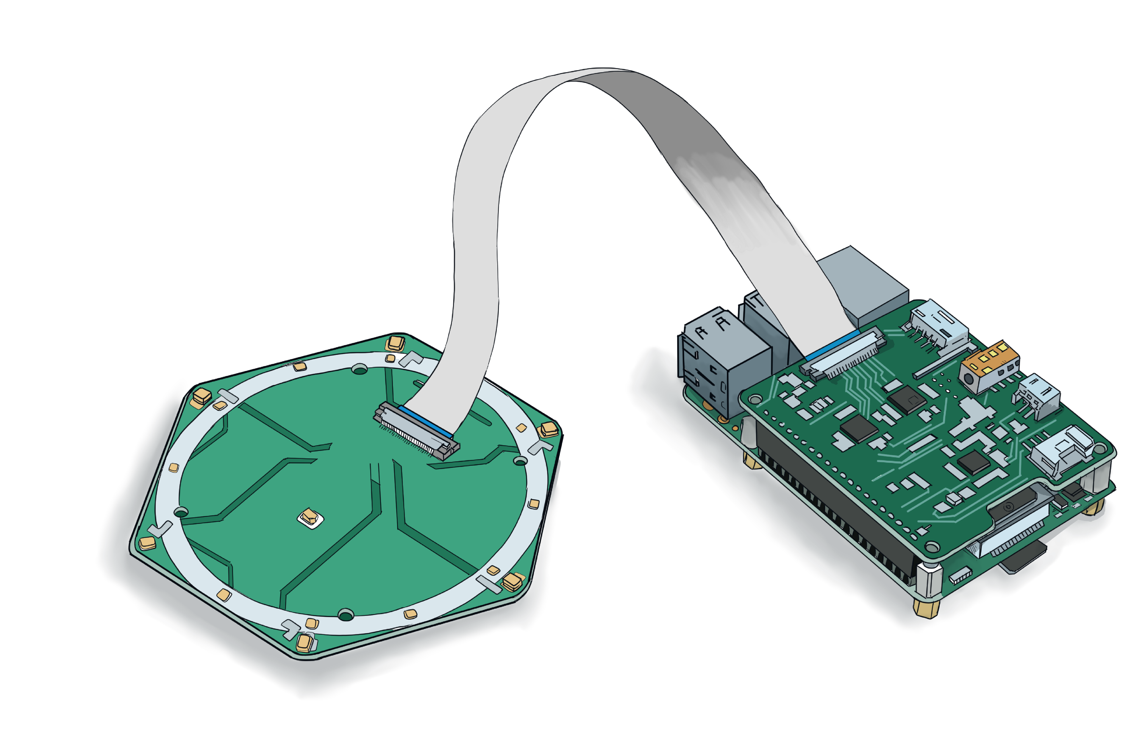
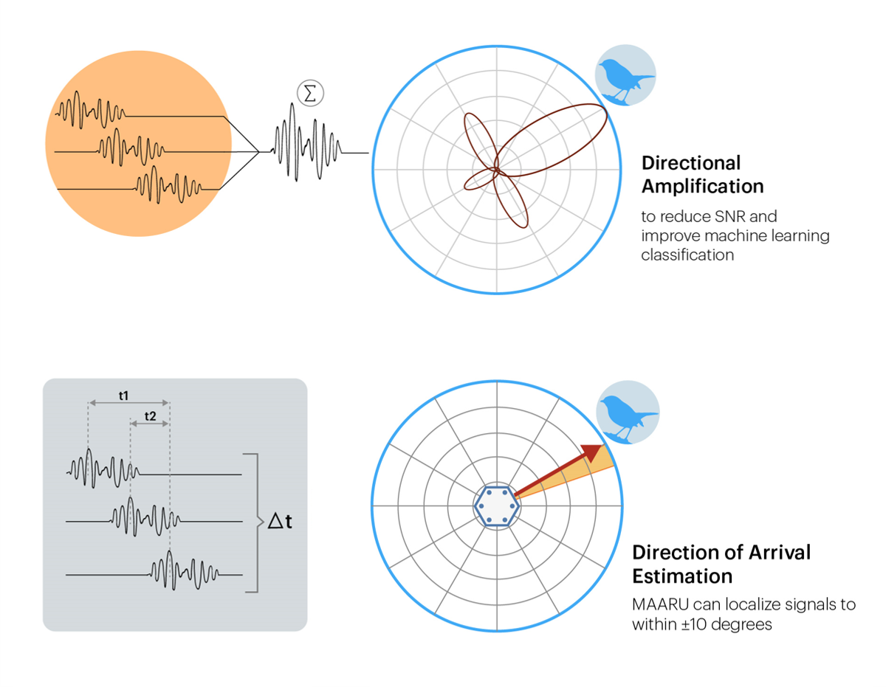
https://beckyheath.github.io/MAARU/

Slide 7
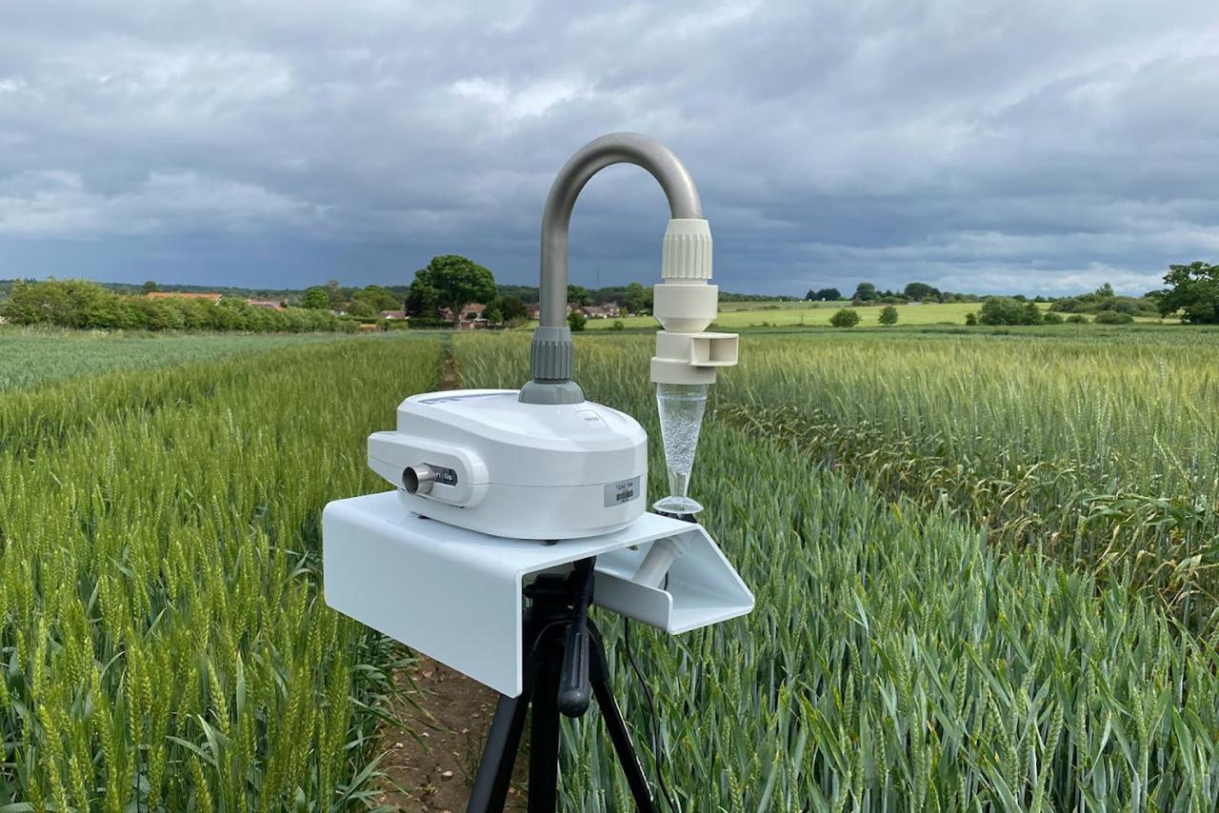
https://air-seq.com/

